Slide 1
Decent housing
Team Leader: Jacob Kihila (ARU)
Patrick Willems (KU Leuven))

Slide 2
Decent Housing: Towards improved urban water supply and sustainable sanitation resource recovery, energy and materials uses

Slide 3
Context analysis
Sanitation
62.75% of households are using improved latrines and only 13% connected to sewerage
22.85% have hand washing facilities
30.67% treat their drinking water (NSMIS, 2019)
Dar es Salaam generates 4,161 tonnes of solid waste per day. Out of these, 37% (1,533 tonnes) is collected and less than 200 tonnes per day are recycled
Energy access still a challenge
Demand for sustainable materials is increasing with urbanization
Challenges
Water demand
Emptying cost
Demand for space
Inadequate designated disposal site for wastewater treatment
Adequate supply of water
Sludge management
Notes:
Improved latrines (69.7%) require adequate supply of water, good hygienic practices and clear plan on how to manage wastewater when the septic tanks are full especially for those who are using pour flush and pit latrines.
Disposal of wastewater from households is still a challenge due to the cost of emptying, inadequate designated disposal site for wastewater treatment and sludge management.

Slide 4
Project objectives
To contribute towards improved urban water supply and sustainable sanitation resource recovery, energy and materials uses for decent housing.
This will be achieved through research, training and societal engagement in issues related to;
access to clean and safe water
improved sanitation and enhanced resources recovery from solid wastes and wastewater
deployment of off-grid/mini-grid electrification through renewable energy and
use of potential sustainable building materials.

Slide 5
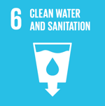
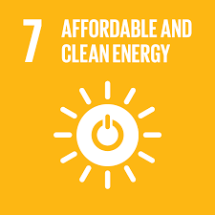
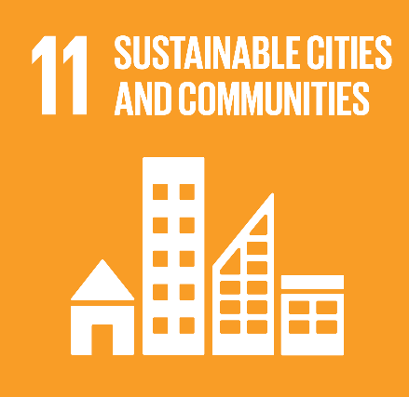
Project thematic areas
Decent housing
Water
Building materials
Energy
Sanitation
SDGs

Slide 6
Access to clean and safe water
Techniques for harvesting, conservation strategies and water quality improvement options will be investigated under this area.
Investigation of alternative water sources and quality surveys, exploration of the potential and techniques for rain water harvesting will be carried-out

Slide 7
Improved sanitation and enhanced resources recovery
The project will undertake mapping of different types of wastes that have potential for resource recovery
Laboratory and pilot scale experiments on optimal generation of sanitation products using various waste-feacal sludge mixes for optimal biogas generation, briquettes and fertilizer
Techno-economic evaluations (with artificial intelligence) and development of strategies for the scale up

Slide 8
Electrification through renewable energy
Exploration of the potential renewable energies, testing the technologies via mini grid approach.
Investigation on applications such as solar energy (photovoltaics and solar heating), windmills and biogas production will be done.
Options/ways to integrate renewable energy systems with water, sanitation will be sought.
Strategies for scale up of the technologies and for building the capacity of communities on renewable energy will be investigate

Slide 9
Sustainable building materials
An inventory of existing material flows will be made in order to critically reflect on the environmental impact and to detect potential improvements or alternatives for lower impact construction
Research on alternative building materials such as from waste

Slide 10
Medium-term Impacts
Medium-term:
Water sources and quality databases created, Cost effective technologies developed, Sanitation business models developed, Sanitation useful products developed,
General design principles, guidelines and recommendations for more sustainable material use and specific sustainable building solutions developed.
The expected outcome is the uptake of the sustainable energy, water and resource recovery and building material technologies.

Slide 11
Long-term impacts
Improved public health; Improved community livelihoods and wellbeing; Enhanced sustainable resource use
Availability of evidence based information for decision making on resource recovery, water quality and green infrastructure, sustainable energy systems and sustainable material use by policy makers;
Strengthen ARU’s institutional network
Capacity building (PhD, MSc, Tailor made trainings, short courses)
Dissemination (articles, policy briefs )
Community outreach –technology transfer

Slide 12
Thank you for your attention

